Slide 1
GROUP DISCUSSION

Slide 2
Group Discussion is a modern method of assessing students’ personalities.
It is both a technique and an art and a comprehensive tool to judge the worthiness of the student and his appropriateness for the job.

Slide 3

GD is not an Argument

Slide 4
Difference between Discussion, Debate and GD
Debate – Either Winning or Losing.
Discussion – Expression of your point of view and respecting another's point of view.
A GD, however, calls for a lot more maturity and logic as it is sharing our own ideas and thoughts with the group.

Slide 5
Why do GD’s are held?
To prepare you for the future and make you well informed.
To make you listen and talk in a mature and logical manner.
If you need to disagree, then doing so in a graceful manner.
Attacking issues not people.
Carefully listen to other people's points and try to refine your own by using other people's inputs on the subject.

Slide 6
How to Prepare for Group Discussion?
Awareness of Topics Relating to Your Background Is Crucial.
Take the Lead.
There Is No Place for Aggression in Group Discussions.
Communicate Effectively.
Listen Carefully, Do Not Just Hear.
Work On Your Body Language.
Avoid Deviating From the Topic.
Be the First to Summarize the Discussion.

Slide 7
Skills for Effective Participation in GD
The aspects which make up a GD are verbal communication, non-verbal behavior, conformation to norms, decision-making ability, and cooperation.

Slide 8
Initiating a Group Discussion
Introduce yourself.
Communicate clearly and fluently. While you introduce yourself and the topic, try not to stutter or stammer.
Present the topic with an interesting take.
Keep the content relevant.
Use questions and quotes.
Use your time efficiently.
Listen intently.
Maintain relevance.

Slide 9
TYPES OF GD:
GD can be Topic based or Case based-
Topic based group discussion can be of three types:
Factual topics
Controversial topics
Abstract topics

Slide 10
FACTUAL TOPICS
Factual topics are about practical things, which an ordinary person is aware of in his day to day life
Typically they are socio- economic topics. These can be the current topic.
Such topics gives a candidate a chance to prove that he is aware of and sensitive to his environment.

Slide 11
CONTROVERSIAL TOPICS
They are the ones that are argumentative in nature. They are meant to generate controversy.
In GDs where such topics are given for discussion the noise and temper is usually high.
The idea behind giving such topic is likely to see how much maturity the candidate is displaying by keeping his temper in check.

Slide 12
ABSTRACT TOPICS
Abstract topics are about intangible things.
These topics are used to check your lateral thinking and creativity.
Eg: the number 10
Joy
Color red

Slide 13
CASE BASED GD
Another variation is the use of case instead of a topic.
The case study tries to simulate a real life situation . Information about the situation will be given to you and you would be asked as a group to resolve the situation.
In case study there are no incorrect answers or perfect solutions.
The objective is to get you think about the situation from various angles.

Slide 14
What does GD check?
Communication Skills
Knowledge
Reasoning ability
Leadership Skills
Flexibility
Convincing power
Ability to work in team
Creativity
Group Dynamics
Level of maturity
Interpersonal skills
Initiative attitude

Slide 15
Preparation for GD?
GD reflects the inherent qualities of an individual .
Reading: This is the first and the most crucial step in preparation.
Mocks: Create an informal GD group and meet regularly to discuss and exchange feedback.

Slide 16
Personalities Reflected in a GD
Passive
Submissive
Hesitates to Take Initiative
Assertive
Open to Accept Ideas
Initiates and Encourages others
Aggressive
Dominating
Argumentative

Slide 17
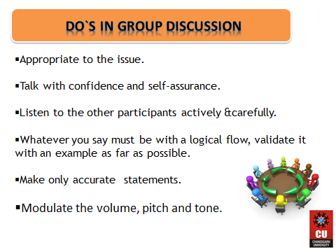


Slide 18
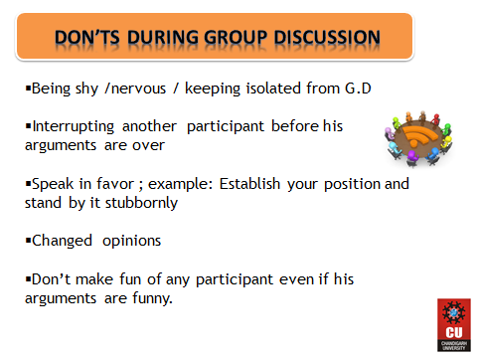

Slide 19
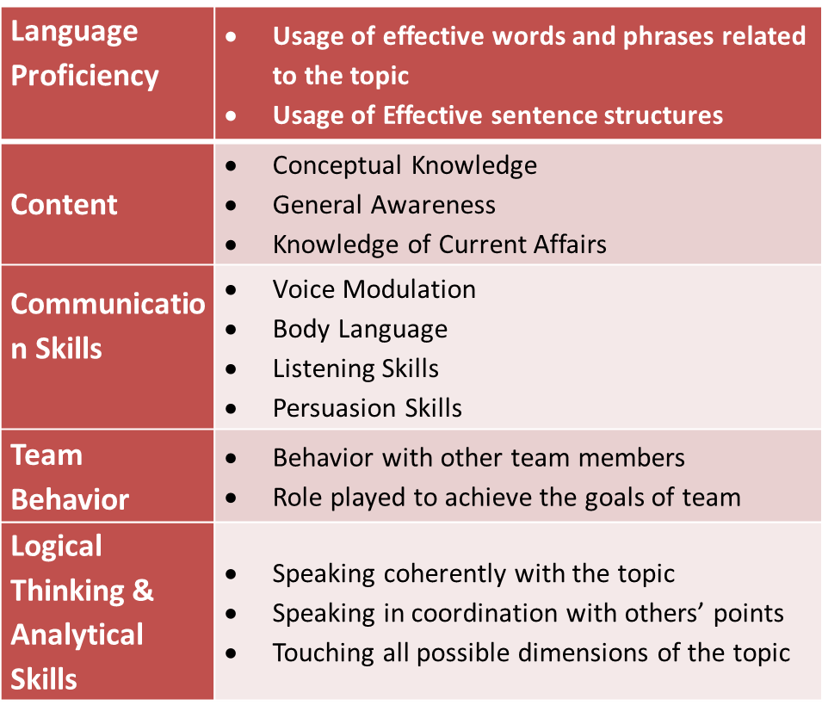
Parameters of Evaluation in GD

Slide 20
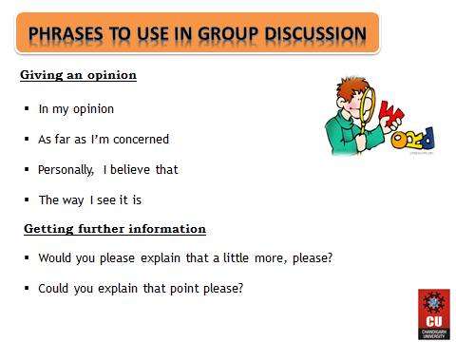

Slide 21
TIPS FOR PARTICIPATION in GD…
Taking a Position viz-a-viz the Topic…
Always take a holistic view of the topic
Avoid statements like:
- “I whole heartedly support the topic”
- “I completely disagree with the topic”
Start as, “there are points in favor of and against the topic…..”

Slide 22
If You have a Soft Voice…
Raise voice level but do not shout
Look for moments when the noise levels are not very high and get into the discussion.
If You are Interrupted while Discussing your Topic…
Tell in clear and unambiguous terms that you should be allowed to speak
You can say:
Excuse me, please let me complete
Just a minute-let me finish my point
Raise your voice slightly

Slide 23
How to Get into the Discussion…
Take Initiative
Be attentive and get into discussion comfortably.
Identify strong speakers and soft speakers in the group.
Get into Discussion…
By using sentences like
“Yes, what you say is true…..”
“….but there is something more that we should look at…”
“…and there is another reason to support what you say…”

Slide 24
Summarization Techniques
Most GD’s do not really have conclusions.
Keep the following points in mind while summarizing a discussion:
Avoid raising new points.
Avoid stating only your viewpoint.
Avoid dwelling only on one aspect of the GD.
Keep it brief and concise.
It must incorporate all the important points that came out during the GD.
If the examiner asks you to summarize a GD, it means the GD has come to an end. Do not add anything once the GD has been summarized.

Slide 25
The Perfect Candidate
Be attentive
Personal appearance
Answering questions completely
Wide knowledge
Positive attitude and behavior
Good communication skills

Slide 26
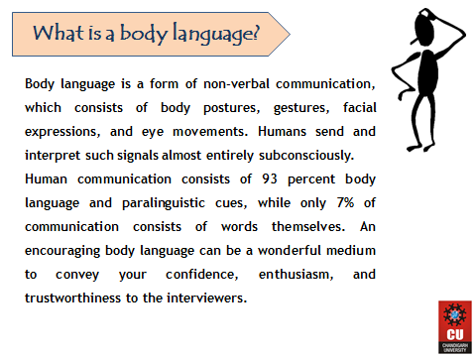

Slide 27
Making a good “First Impression”
The way you dress is the single biggest nonverbal communication you make about yourself.
Your dress conveys success, trustworthiness, intelligence, and suitability.
Lean towards the conservative side of style.
Avoid loud colors and printed fabrics
Make sure your clothes are nicely pressed.
Bring an extra tie, shirt or scarf

Slide 28

Body
Remember the DIGIT
4

Slide 29
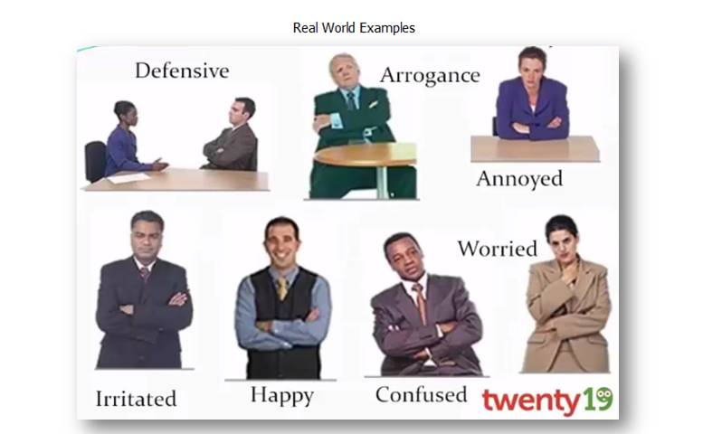

Slide 30
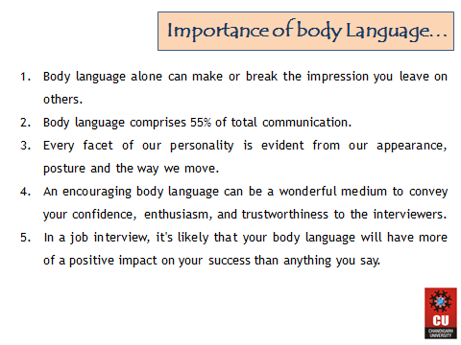

Slide 31
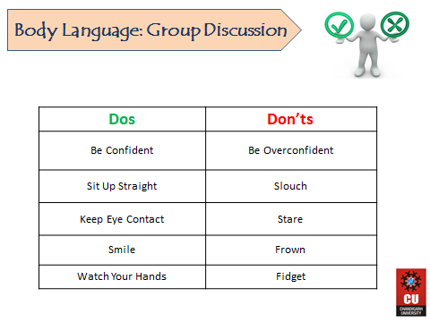

Slide 32
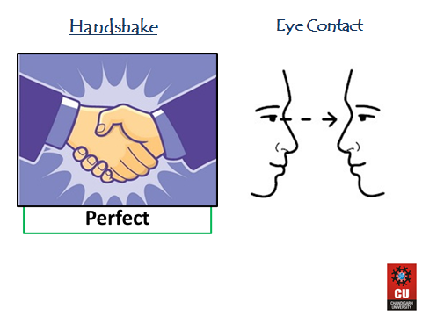

Slide 33
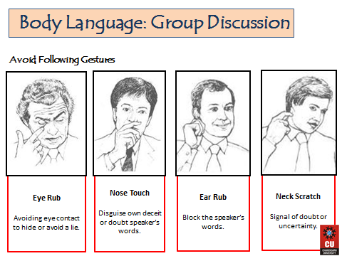

Slide 34
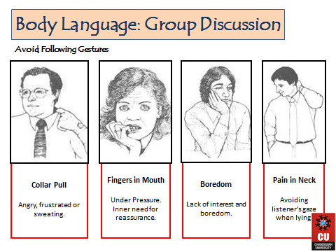

Slide 35
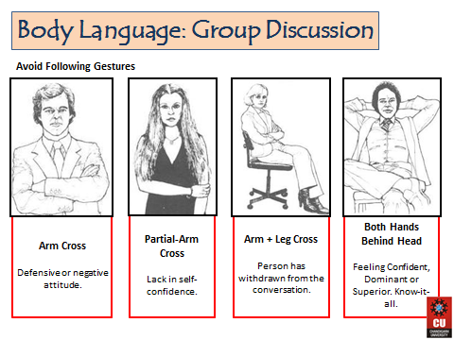

Slide 36
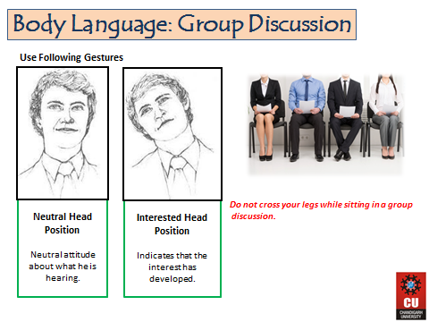

Slide 37
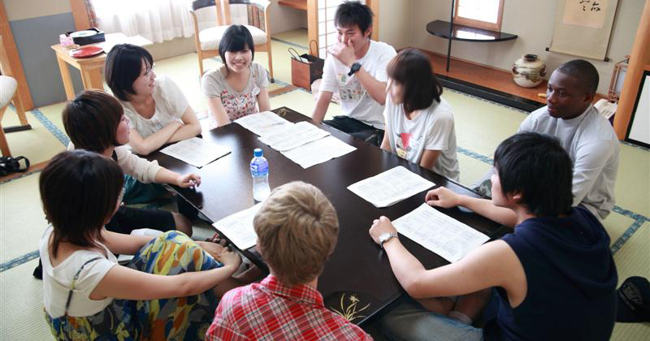

Slide 38


Slide 39
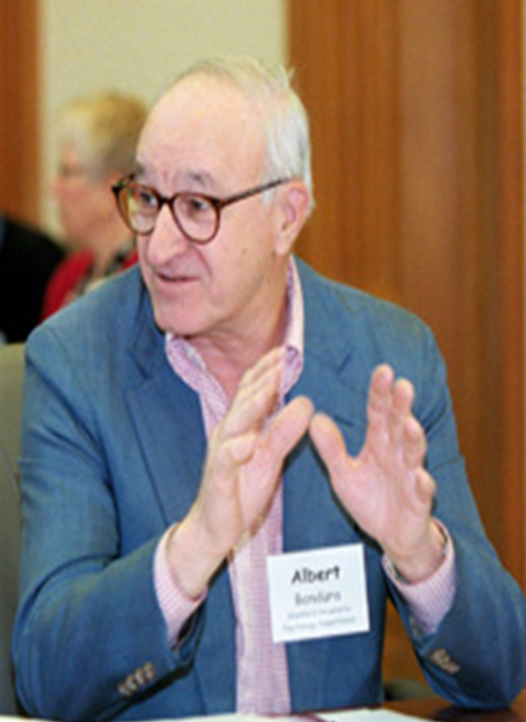
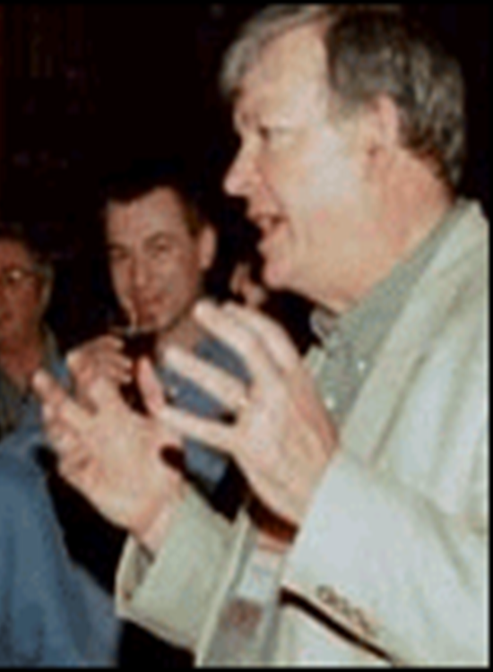
Be Like this…………

Slide 40
Few GD Topics
E- books or printed books: what's your choice?
Government schools Vs private schools
Demonitization– success or publicity
Hard work or smart work – Which is better
Should politicians have a retirement age?
Should capital punishment be legal? Yes or no

